Slide 1

Notes:
FabConEurope24 Branded Splash Screen
Slide #1 on all presentations.
The speaker should not edit, move or delete this slide.

Slide 2

Build Your First End-to-End Lakehouse Solution
Notes:
Presentation Title Slide
Please input your presentation title, your name, title, company name and country.

Slide 3



Instructors
Abid Nazir Guroo
Senior Product Manager,
Customer Advisory Team
Arshad Ali
Principal Product Manager,
Fabric DE&DS Product Group
Venk Titte
Principal Product Manager,
Customer Advisory Team
Notes:
Main Content Slide: Title / Copy Text
Use this slide for inserting text-only information into the Main Content of the presentation.
The text is preformatted with font and colour styles.
Font-size can be altered to allow the content to fit the slide correctly.
The Title Text Box can be deleted if not required.

Slide 4
Category | Description
Workshop Format | This is a hands-on workshop. You’ll be actively involved in coding, implementing, and problem-solving.
What to Expect | Real-world scenarios and exercises. Direct application of concepts in live environments.
Participant Engagement | Please have your laptops and necessary tools ready. Prepare to code, collaborate, and share insights.
Hands-on | Please delve into the detailed descriptions provided for each exercise and step. Examine the attached screenshots carefully, and note the sequential visualization presented as 1), 2), 3). Review them thoroughly.
Support and Collaboration | Instructors and facilitators are here to guide you. Feel free to ask questions and help your fellow participants.
Outcome | By the end of this workshop, you'll have practical experience and new skills to apply directly to your projects.
Notes:
Main Content Slide: Title / Copy Text
Use this slide for inserting text-only information into the Main Content of the presentation.
The text is preformatted with font and colour styles.
Font-size can be altered to allow the content to fit the slide correctly.
The Title Text Box can be deleted if not required.

Slide 5
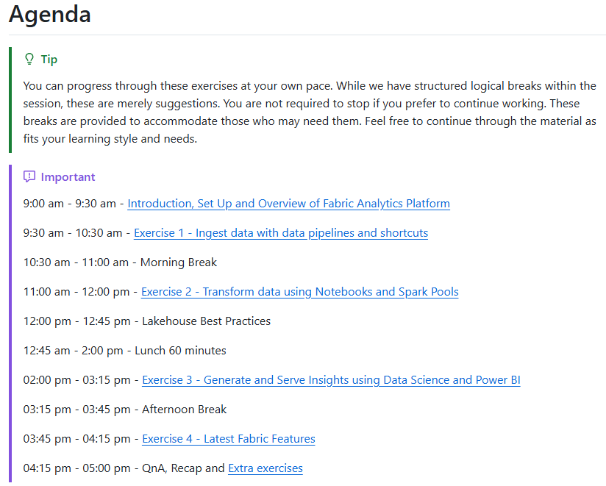

https://aka.ms/fabconlake

Slide 6
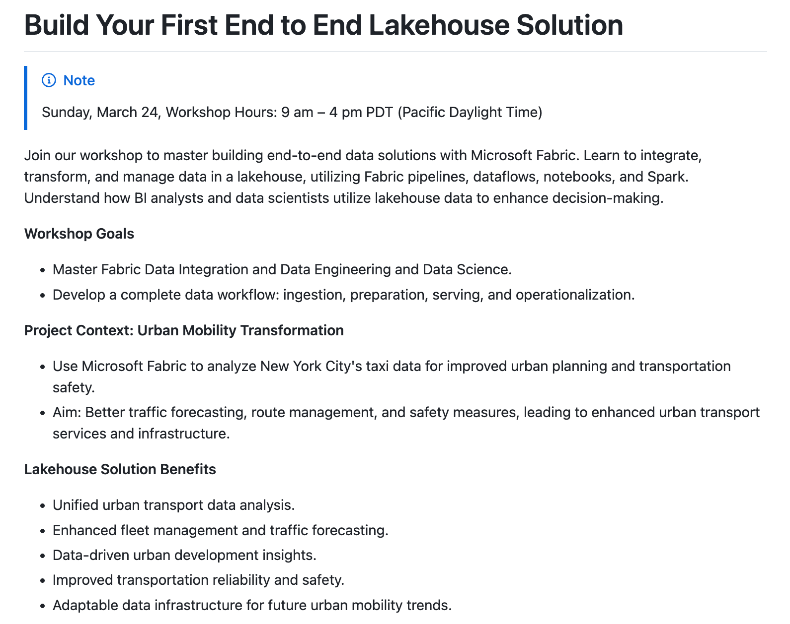
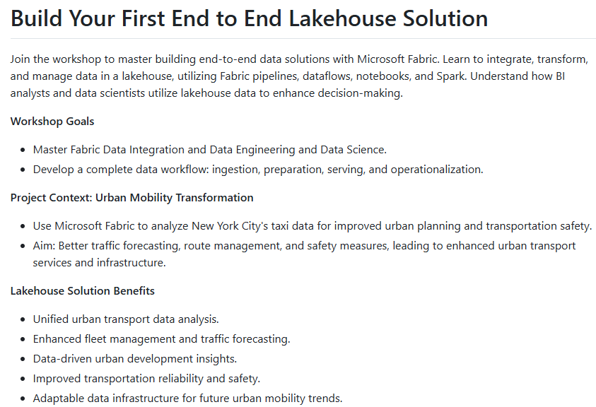
https://aka.ms/fabconlake

Slide 7
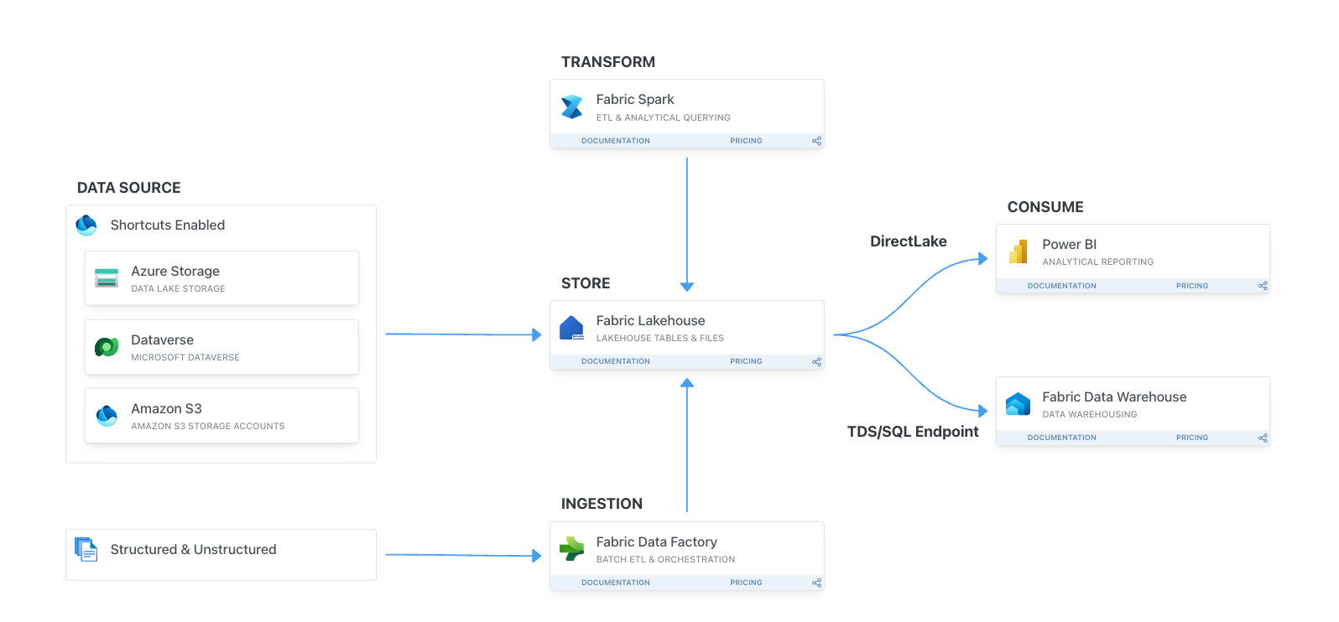
https://aka.ms/fabconlake

Slide 8
Enjoy, experience, network and learn!
Notes:
Section Break Slide
Use this slide for starting a new section of the presentation.
Input the name of the section in the text field.

Slide 9
Three Questions
Notes:
Section Break Slide
Use this slide for starting a new section of the presentation.
Input the name of the section in the text field.

Slide 10
Raise your hand if you have ever tried Microsoft Fabric before. This could be in any context, just any prior exposure at all.
#1
Notes:
Section Break Slide
Use this slide for starting a new section of the presentation.
Input the name of the section in the text field.

Slide 11
Raise your hand if you have explored more than three contexts within Fabric, such as Power BI, Data Science, Data Factory, or Data Engineering.
#2
Notes:
Section Break Slide
Use this slide for starting a new section of the presentation.
Input the name of the section in the text field.

Slide 12
Raise your hand if you, or your company, have faced challenges with orchestrating and integrating different tools to ingest, process, and maximize the value from data.
#3
Notes:
Section Break Slide
Use this slide for starting a new section of the presentation.
Input the name of the section in the text field.

Slide 13
Step 0
Set Up and Overview of Fabric Data Platform
Notes:
Section Break Slide
Use this slide for starting a new section of the presentation.
Input the name of the section in the text field.

Slide 14






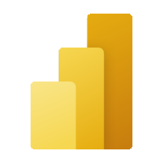
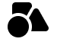



Microsoft Fabric
Partner & Industry workloads
Data Factory
Data Engineering
Data Warehouse
Data Science
Real-Time Intelligence
Power BI
Copilot in Fabric
OneLake
Microsoft Purview
Notes:
Fabric combines the best of Microsoft Power BI, Azure Analytics, and Azure Data Factory to create a single, unified software as a service (SaaS) platform with seven core workloads—each purpose-built for specific personas and specific tasks.​
Let’s explore how all these experiences empower data and business professionals alike to unlock the potential of their data and lay the foundation for the era of AI.​ Fabric empowers every team in the analytics process with the role-specific experiences they need, so data engineers, data warehousing professionals, data scientists, data analysts, and business users feel right at home. ​
You can think of Fabric as almost as Office for Data. Just like Office 365 has word for document authoring, PowerPoint for presentations, Excel for spreadsheets, etc. in Microsoft Fabric, you have 7 core workloads. ​
Data Factory provides more than 150 connectors to cloud and on-premises data sources, drag-and-drop experiences for data transformation, and the ability to orchestrate data pipelines.​
Data Engineering enables great authoring experiences for Spark, instant start with live pools, and the ability to collaborate.​
Data Science provides an end-to-end workflow for data scientists to build sophisticated AI models, collaborate easily, and train, deploy, and manage machine learning models. ​
Data Warehousing provides a converged lake house and data warehouse experience with industry-leading SQL performance on open data formats.​
Real-Time Intelligence enables developers to work with data streaming in from the Internet of Things (IoT) devices, telemetry, logs, and more, and analyze massive volumes of semi-structured data with high performance and low latency.​
Power BI in Fabric provides industry-leading visualization and AI-driven analytics that enable business analysts and business users to gain insights from data. The Power BI experience is also deeply integrated into Microsoft 365, providing relevant insights where business users already work. ​
​
Copilot in Microsoft Fabric uses Azure OpenAI Service to make jobs easier. ​
​
With Copilot in Power BI, we are infusing the power of large language models into Power BI at every layer to help users get more done and create more value from their data. Using Copilot, you can simply describe the visuals and insights you’re looking for, and Copilot will do the rest. Users can create and tailor reports in seconds, generate and edit DAX calculations, create narrative summaries, and ask questions about their data, all in conversational language. With the ability to easily tailor the tone, scope, and style of narratives and add them seamlessly within reports, Power BI can also deliver data insights even more impactfully through easy-to-understand text summaries.
All these experiences are built on a unified data foundation with OneLake. This open and governed lake-centric hub eliminates data siloes and securely centralized data for the whole organization. It acts like the data version of Microsoft OneDrive and is automatically wired into every Fabric workload and designed to help you simplify data management and reduce data duplication. OneLake shortcuts allow you to virtualize data into OneLake from across clouds, accounts, and domains, with sources like Azure Data Lake Storage Gen2 and Amazon S3—all without duplication, movement, or changes to metadata or ownership. OneLake’s open data format means you only need to load the data into the lake once and you can use the single copy across every Fabric workload and engine, minimizing data duplication and sprawl, increasing visibility, accuracy and productivity across your organization.

Slide 15






Seven key workloads for end-to-end analytics
Workloads are designed to target specific personas and tasks, yet work together seamlessly in a unified platform via OneLake to enable creators to collaboratively do their best work
Data Factory
Unify your data estate with a data integration experience and 300+ data transformations to easily solve the most complex ETL scenarios
Data Engineering
Enable data engineers to design, build, and maintain infrastructures at scale using World-class Spark platform with great authoring experiences to
Data Warehouse
Provide industry-leading SQL performance and scale, fully separating compute from storage for independently scaling and natively storing data in open Parquet/Delta Lake
Data Science
Empower data scientists and analysts to quickly build, deploy, and operationalize sophisticated AI directly within Fabric
Real Time Intelligence
Ingest streaming data with high granularity, dynamically transform streaming data, query data in real-time for instant insights, and trigger actions
Power BI
Make better, data-driven decisions with the world’s leading business intelligence platform that turns unrelated sources of data into coherent, interactive insights
Notes:
Microsoft Fabric is a unified SaaS based solution comprised of seven key workloads, designed to target specific personas and tasks, while working seamlessly together on a unified lake-first foundation. Together, these seven workloads help organizations unlock the transformative value of data. Let us look at each of these key workloads in detail.

Slide 16
Unified data foundation with OneLake
Manage and analyze all your data across your organization in a unified, secure, and centralized SaaS data lake for everyone with OneLake––the “OneDrive” for data
A single and open, logical SaaS lake for the whole organization
Data
Factory
Data
Engineering
Data
Science
Data Warehouse
Real Time Analytics
Partner & Industry workloads
Power BI
OneLake supports any type of file, structured or unstructured
One copy of data for use with multiple analytical engines
OneLake
Enable virtualization of data without duplication using shortcuts
All workloads automatically store their data in OneLake in Delta Parquet format
Data in OneLake is automatically indexed for discovery, sharing, governance, and compliance
Intelligent data foundation
Notes:
These workloads are built on a unified data foundation via OneLake. This open and governed lake-centric hub eliminates data siloes and securely centralized data for the whole organization. It acts like the data version of Microsoft OneDrive.

Slide 17
Exercise 1
Ingest data with data pipelines
and shortcuts
Notes:
Section Break Slide
Use this slide for starting a new section of the presentation.
Input the name of the section in the text field.

Slide 18
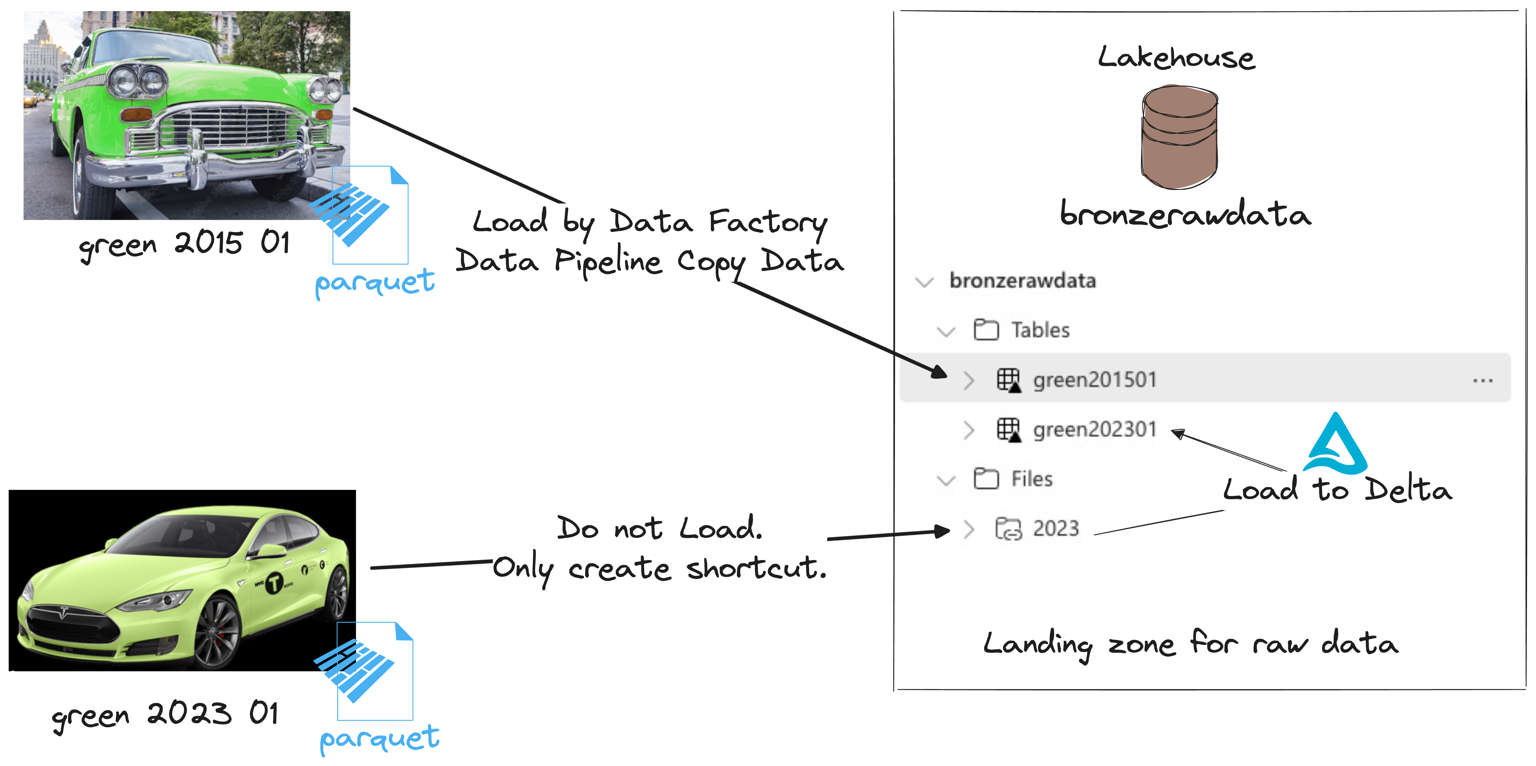
Exercise 1
Ingest data with data pipelines and shortcuts

Slide 19
Break 15’
Grab a coffee, stretch your legs, and get ready for the upcoming challenges!
Notes:
Section Break Slide
Use this slide for starting a new section of the presentation.
Input the name of the section in the text field.

Slide 20
Exercise 2
Transform data using Notebooks and Spark clusters.
Notes:
Section Break Slide
Use this slide for starting a new section of the presentation.
Input the name of the section in the text field.

Slide 21
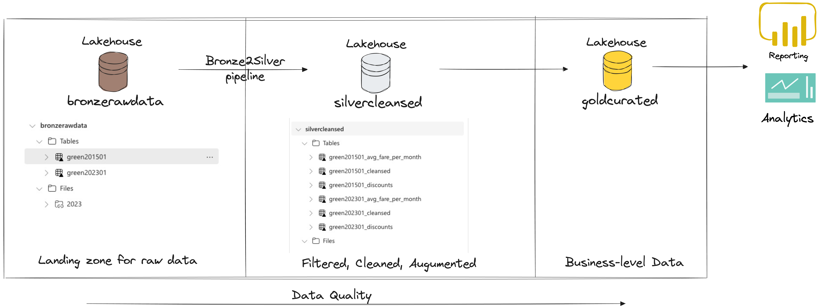
Exercise 2
Transform data using Notebooks and Spark clusters

Slide 22
Lunch Break 60’
Enjoy your lunch!
Notes:
Section Break Slide
Use this slide for starting a new section of the presentation.
Input the name of the section in the text field.

Slide 23
Exercise 3
Collaborate inside Notebooks and share Lakehouse. Use SQL Endpoint and SSMS.
Notes:
Section Break Slide
Use this slide for starting a new section of the presentation.
Input the name of the section in the text field.

Slide 24
Break 15’
Grab a coffee, stretch your legs, and get ready for the upcoming challenges!
Notes:
Section Break Slide
Use this slide for starting a new section of the presentation.
Input the name of the section in the text field.

Slide 25
Exercise 4
Serve and consume data using Power BI and Data Science.
Notes:
Section Break Slide
Use this slide for starting a new section of the presentation.
Input the name of the section in the text field.

Slide 26


Data science in Microsoft Fabric End-to-end data science for predictive business insights
Developer friendly
SaaS experiences with quick setup
Code authoring experiences in Notebooks and IDE
VS Code integration
Rich ML tools
Supports MLFlow model and experiment management
Built-in, scalable ML tools with SynapseML
Direct Lake mode for serving predictions to BI reports
Promotes collaboration
Unified platform for all analytics roles incl. data scientists
Secure and easy sharing of data, code, models and experiments
Data Centric
Easy and secure access to lake-centric data
Open Delta Lake support promotes reproducibility
Native integration with data infrastructure
Notes:
Data Centric:
• Manage data in MS Fabric • Build from Data Lakes to PowerBI
• Open Delta Lake for reproducibility
• Integrate Machine Learning with data infrastructure
Section 2: Developer Friendly:
• Easy to use serverless infrastructure
• Delightful code authoring experiences in Notebooks
• Integration with popular IDEs like VS Code
Section 3:
Rich and Scalable ML:
• Built-in MLFlow model and experiment tracking
• MLFlow Autologging to track parameters and metrics
• SynapseML library on Spark for building and deploying models
• PBI Direct Lake Mode to serve predictions to Power BI Section
4: Streamlined Collaboration:
• Unified Platform for analytics roles
• Securely share data, code, models, and experiments
• Easier collaboration across the team

Slide 27
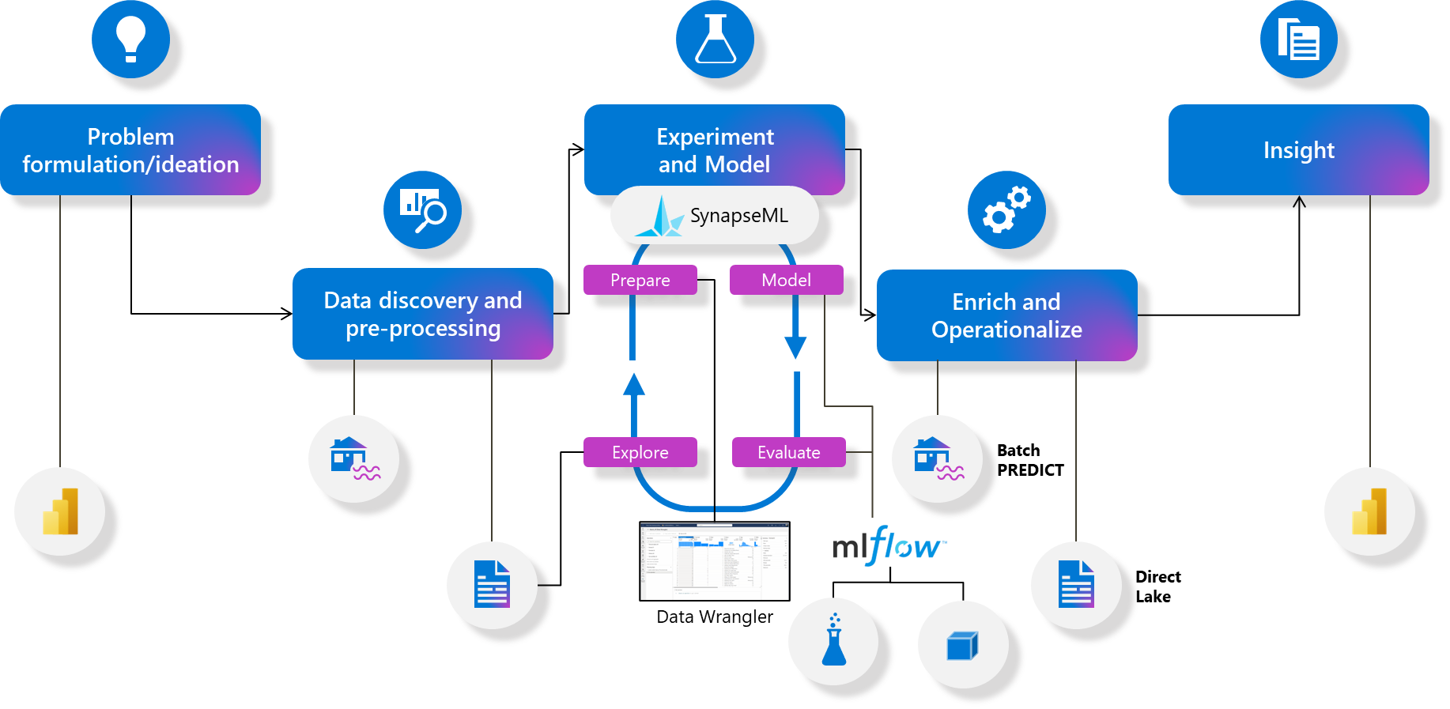
The Fabric Data Science experience
Notes:
We have a key scenario defined for Public Preview
Goal is to make this as smooth as possible
Not only scenario
Now let’s look at some experiences and features we ar eenabling

Slide 28
Exercise 4
Serve and consume data using Power BI and Data Science

Slide 29
Break (up to 3:05 PM)
Grab a coffee, stretch your legs, and get ready for the upcoming challenges!
Notes:
Section Break Slide
Use this slide for starting a new section of the presentation.
Input the name of the section in the text field.

Slide 30
Exercise 5
Latest Fabric Features (DE side)
Notes:
Section Break Slide
Use this slide for starting a new section of the presentation.
Input the name of the section in the text field.

Slide 31
Workshop Recap
Notes:
Section Break Slide
Use this slide for starting a new section of the presentation.
Input the name of the section in the text field.

Slide 32




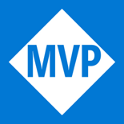
aka.ms/FabricCommunity Connect with community members, ask questions, and learn more about Fabric
Get Involved
in the Fabric
Community
aka.ms/FabricUserGroups
Find a user group that matches your interests in your area or online
aka.ms/SuperUsers
Spread your Fabric knowledge, insights, and best practices with others
aka.ms/MVP Technology experts that share their knowledge and passion with the community
Notes:
Main Content Slide: Title + Dual Visual-Data
Use this slide for inserting two types of visual-data into the Main Content of the presentation.
Font-size can be altered to allow the content to fit the slide correctly.
The Title Text Box can be deleted if not required.

Slide 33

FREE Microsoft Fabric
Certification Exam
Are you ready to get Fabric certified by the end of October?
Claim your 100% discount voucher for Exam DP-600: Fabric Analytics Engineer.
Come find us in the Community Lounge under the Get Certified banner to learn more!
aka.ms/FabCon24/IAmReady
Notes:
Main Content Slide: Title + Dual Visual-Data
Use this slide for inserting two types of visual-data into the Main Content of the presentation.
Font-size can be altered to allow the content to fit the slide correctly.
The Title Text Box can be deleted if not required.

Slide 34
Notes:
End Slide: Rate This Session
Final Slide on all presentations.
The speaker should not edit, move or delete this slide.

Slide 35



Learn more about Microsoft Fabric
Microsoft Fabric
Unify your data to unlock AI innovation

